Slide 1
Cryptography and information security It 3203 Lecture 26
By
Varsha Himthani
Assistant Professor (Selection Grade)
Manipal University Jaipur

Slide 2
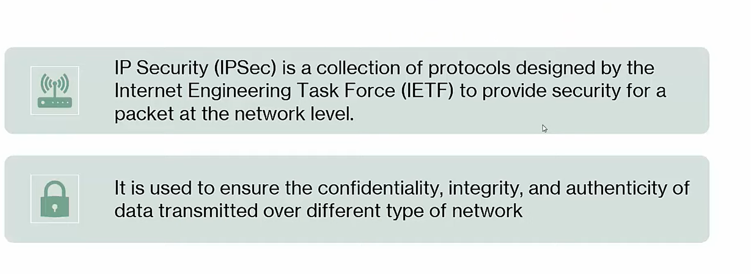
IP SECURITY

Slide 3
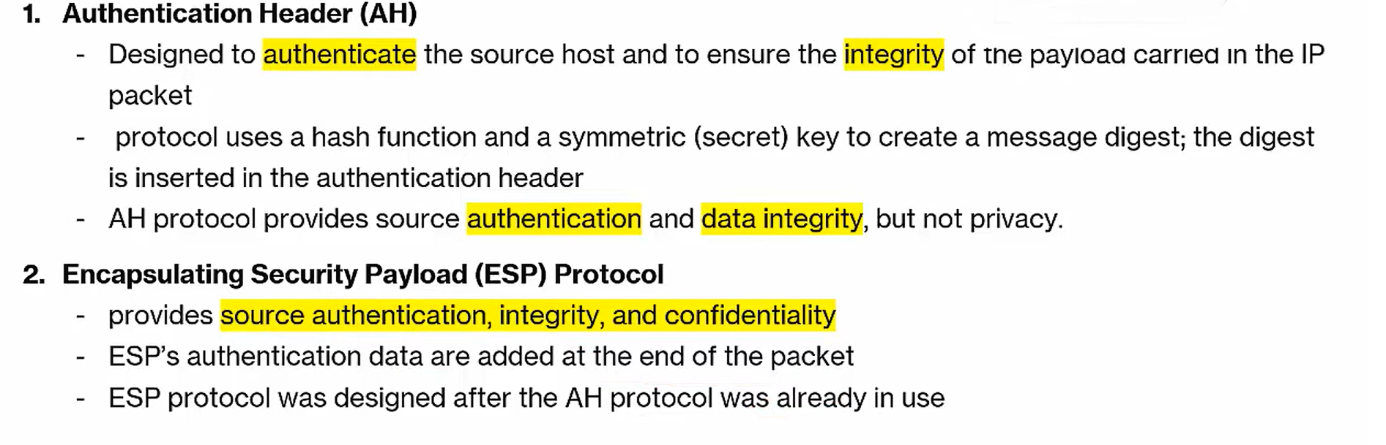
Security Protocols

Slide 4
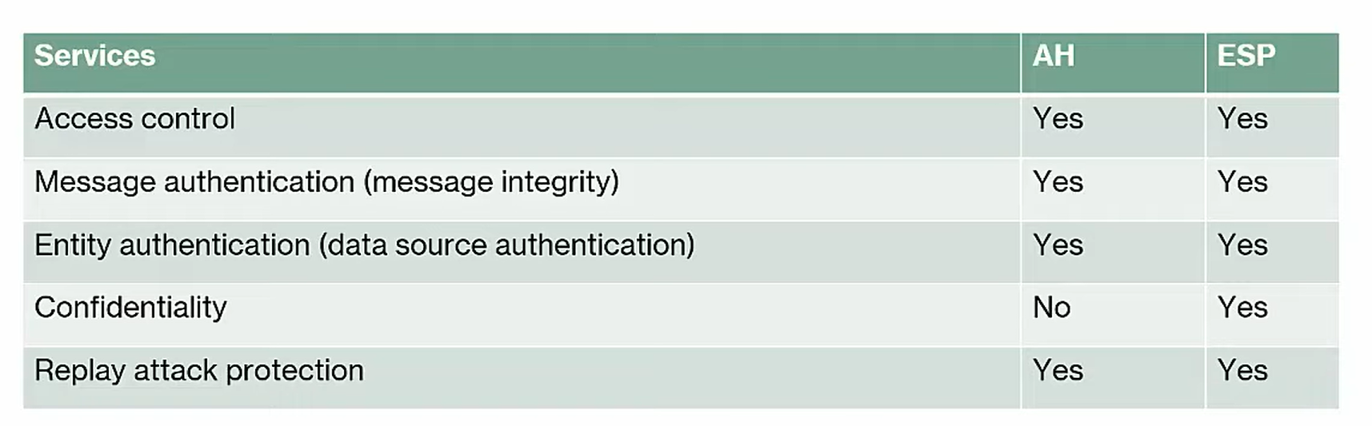
Security Protocols Comparison

Slide 5
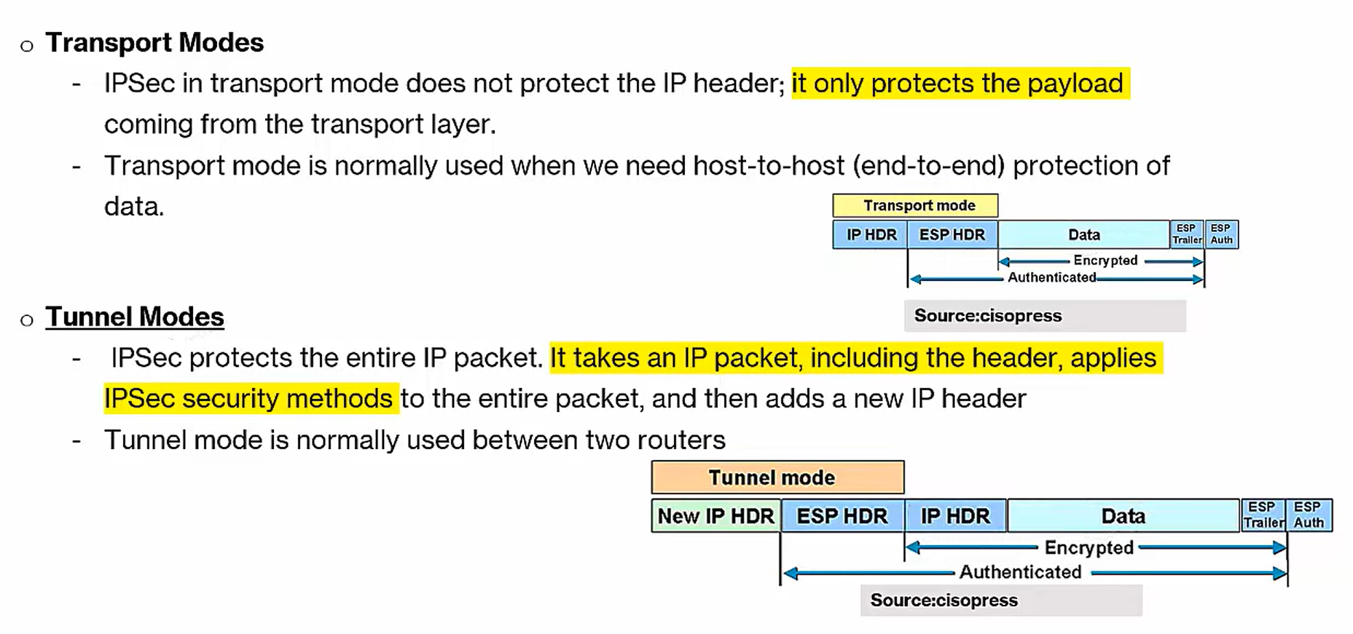
IPSEC Modes

Slide 6
Working of IPSEC
Step 1. Host Recognition
Step 2. IKE Phase 1
Step 3. IKE Phase 2
Step 4. Data Transmission
Step 5. IPSEC Termination

Slide 7
Internet Key Exchange (IKE)
Used to set up a security association (SA)
It is Hybrid protocol consist of:
Oakley
SKEME

Slide 8
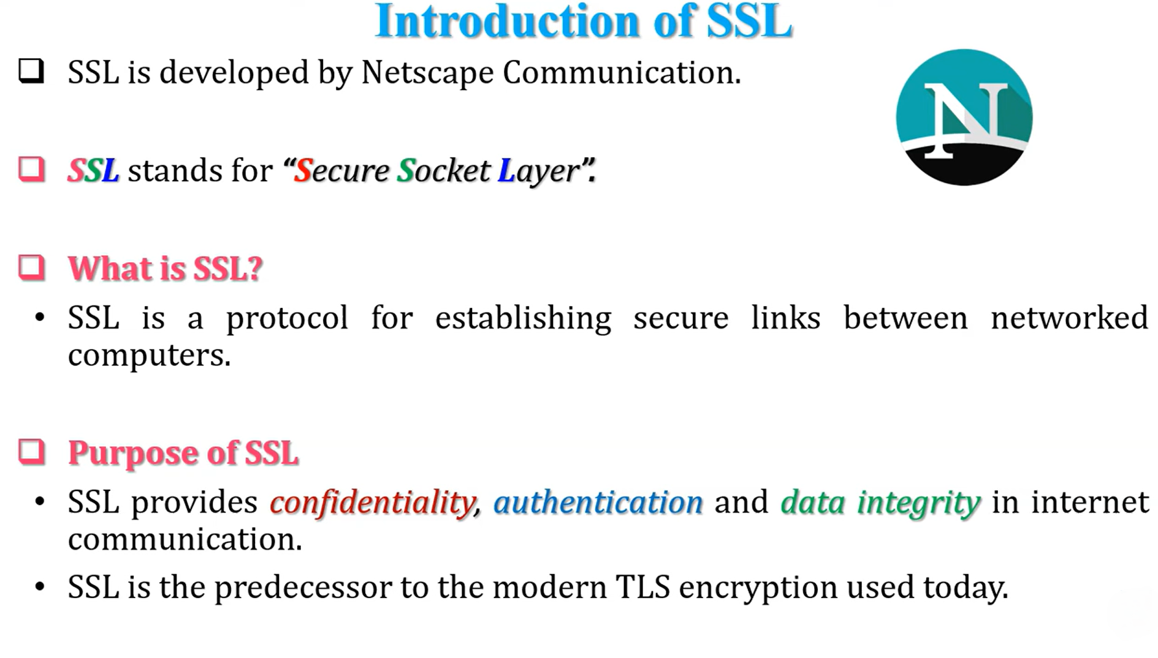
SSL

Slide 9
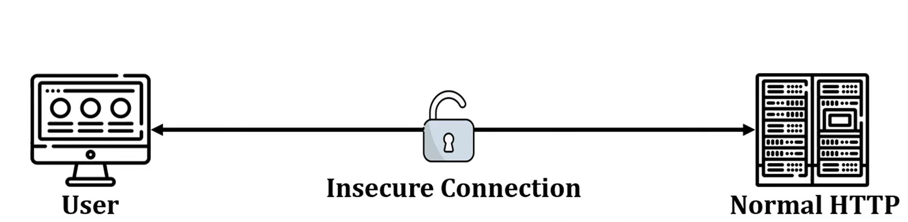
SSL
In this scenario, User want to access server, but the connection is insecure

Slide 10
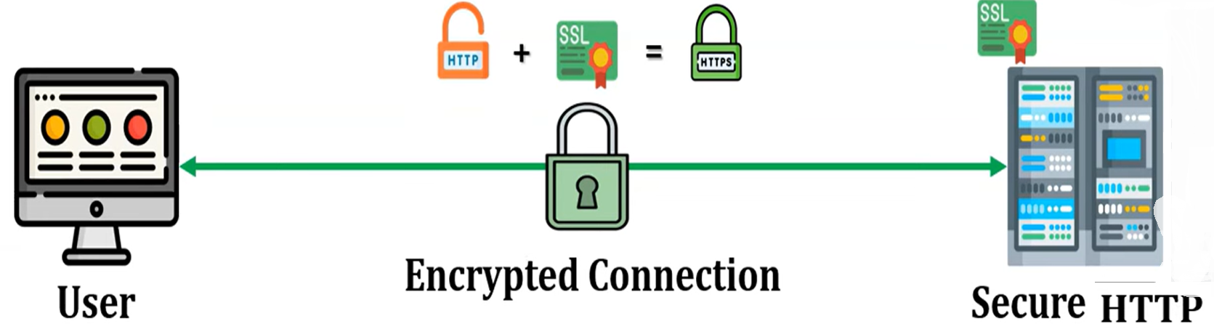
SSL
To provide security HTTPS is used.
When normal HTTP protocol is used with SSL certificate, we call it HTTPS
An SSL certificate is a bit of code on web server that provides security for online communications

Slide 11
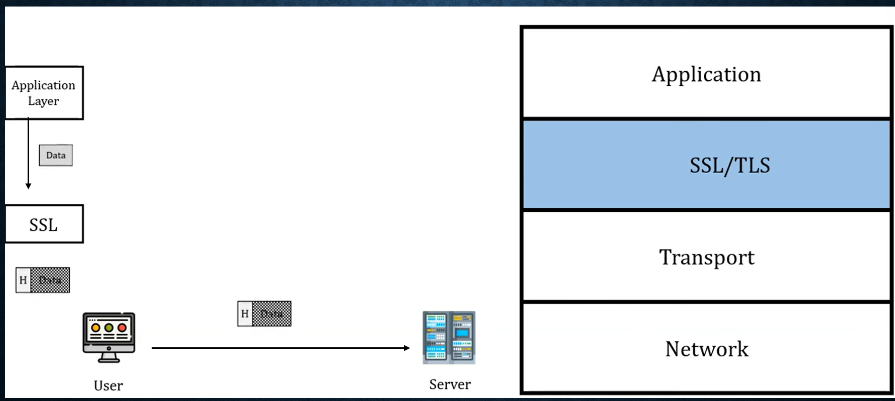
SSL Architecture
SSL encrypts the data received from Application layer of client machine that adds header at SSL
SSL Works between Application and Transport Layer

Slide 12
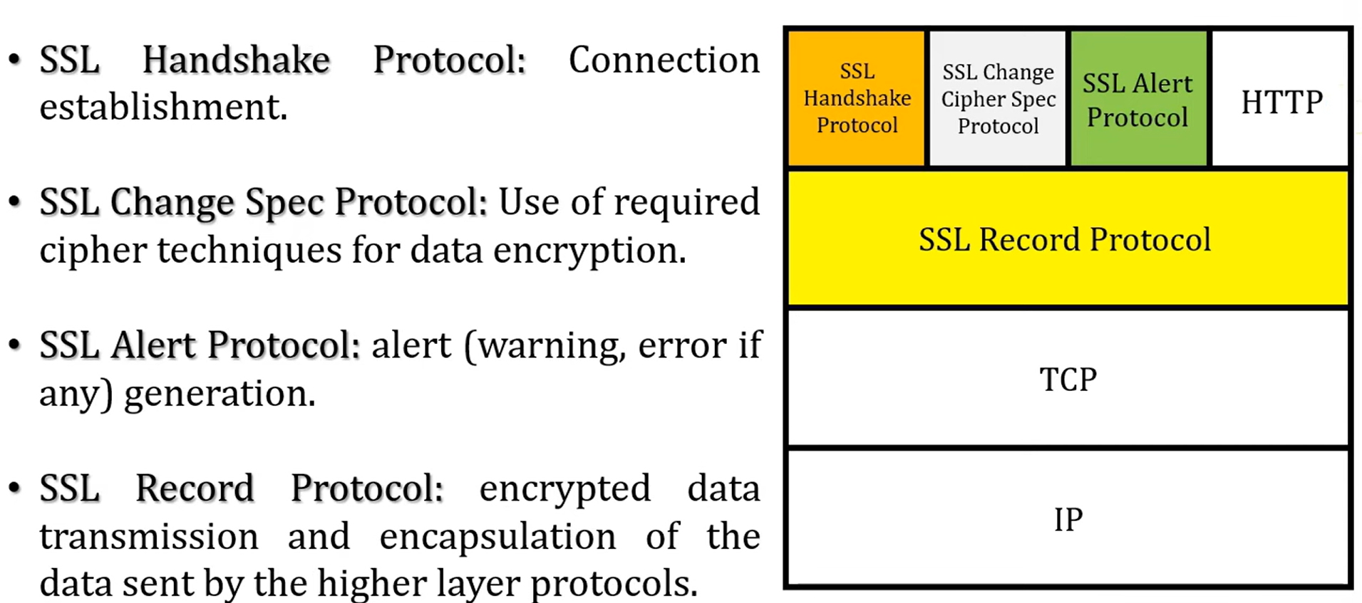
Exploring SSL Architecture

Slide 13
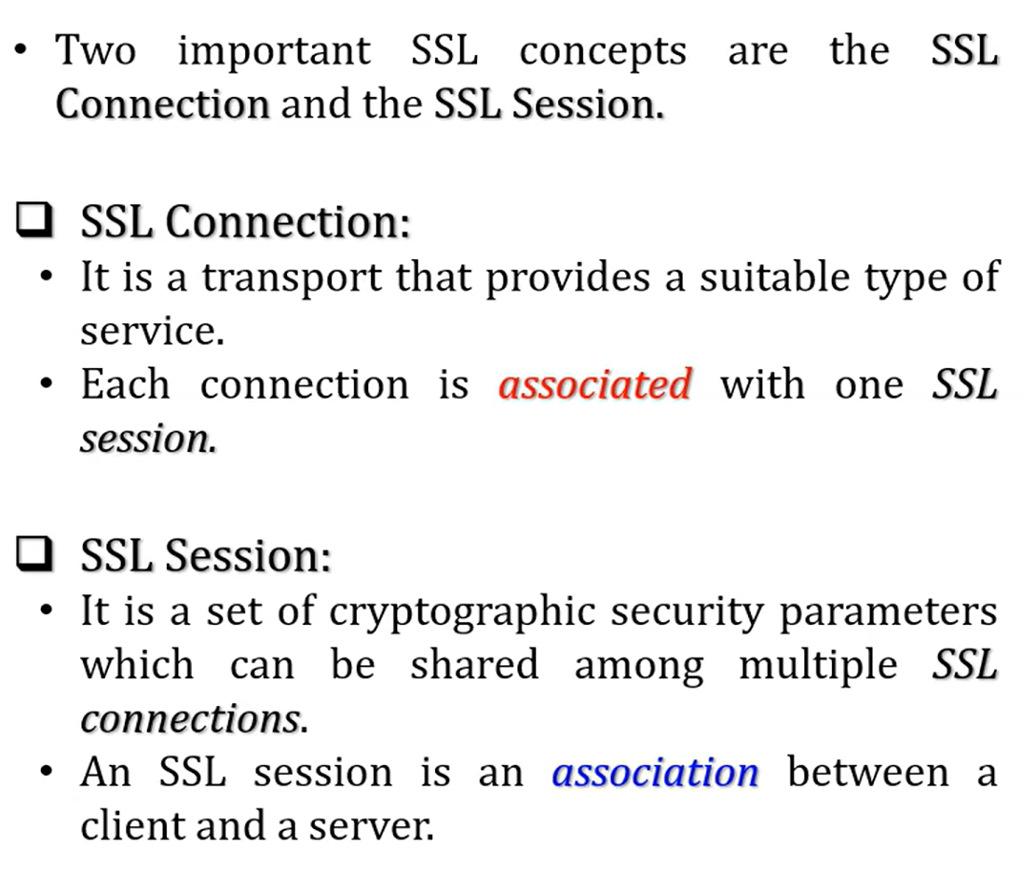
SSL

Slide 14
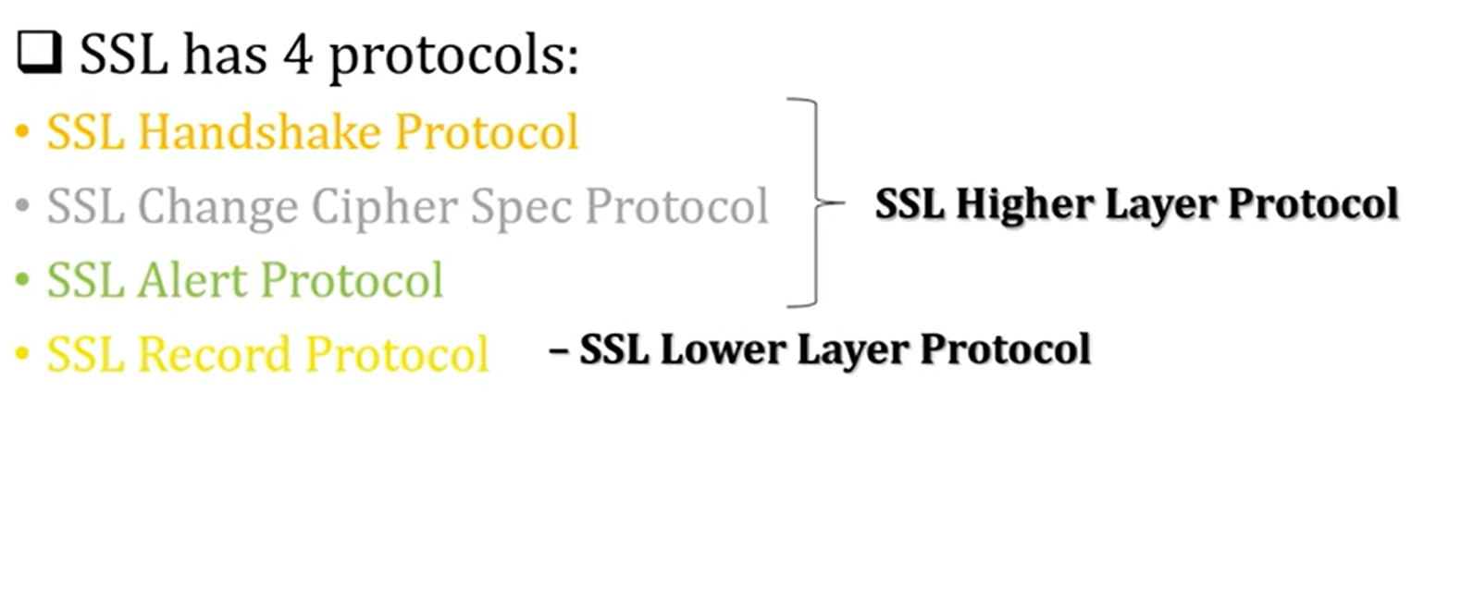
SSL Protocols

Slide 15
SSL and TLS
SSL is an older technology that contains some security flaws.
Transport Layer Security (TLS) is the upgraded version of SSL that fixes existing SSL vulnerabilities.
TLS is an updated, more secure version of SSL.

Slide 16
SSL vs TLS
SSL/TLS handshakes
A handshake is a process in which a browser authenticates a server’s SSL or TLS certificate. This process authenticates both parties, then exchanges cryptographic keys.
An SSL handshake was an explicit connection, while a TLS handshake is an implicit one. The SSL handshake process had more steps than the TLS process. By removing additional steps and reducing the total number of cipher suites, TLS has sped up the process.
Alert messages
Alert messages are how SSL and TLS protocols communicate errors and warnings. In SSL, there are only two alert message types: warning and fatal. A warning alert indicates that an error has occurred, but the connection can continue. A fatal alert indicates that the connection must be terminated immediately. Additionally, SSL alert messages are unencrypted.
TLS has an additional alert message type called close notify. The close notify alert signals the end of the session. TLS alerts are also encrypted for additional security.

Slide 17
SSL vs TLS
Message authentication
Both SSL and TLS use message authentication codes (MACs), a cryptographic technique for verifying the authenticity and integrity of messages. By using a secret key, the record protocol generates the MAC as a fixed-length code and attaches it to the original message.
The SSL protocol uses the MD5 algorithm—which is now outdated—for MAC generation. TLS uses Hash-Based Message Authentication Code (HMAC) for more complex cryptography and security.
Cipher suites
A cipher suite is a collection of algorithms that create keys to encrypt information between a browser and a server. Typically, a cipher suite includes a key exchange algorithm, a validation algorithm, a bulk encryption algorithm, and a MAC algorithm. Several algorithms in TLS were upgraded from SSL due to security concerns.

Slide 18
Thank you

